Slide 1

Chapter 7 – Arrays

Slide 2
Arrays
An array collects a sequence of values of the same type. Create an array that can hold ten values of type double:
new double[10]
The number of elements is the length of the array The new operator constructs the array
The type of an array variable is the type of the element to be stored, followed by
[].
To declare an array variable of type double[]
double[] values;
To initialize the array variable with the array:
double[] values = new double[10];
By default, each number in the array is 0
You can specify the initial values when you create the array
double[] moreValues = { 32, 54, 67.5, 29, 35, 80, 115, 44.5, 100, 65 };

Slide 3
Arrays
To access a value in an array, specify which “slot” you want to use
use the [] operator
values[4] = 35;
The “slot number” is called an index. Each slot contains an element.
Individual elements are accessed by an integer index i, using the notation
array[i].
An array element can be used like any variable.
System.out.println(values[4]);

Slide 4
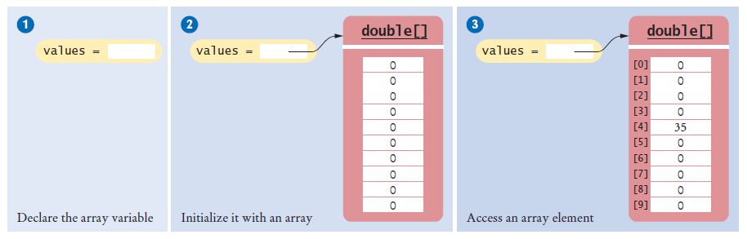
Arrays
Figure 1 An Array of Size 10

Slide 5
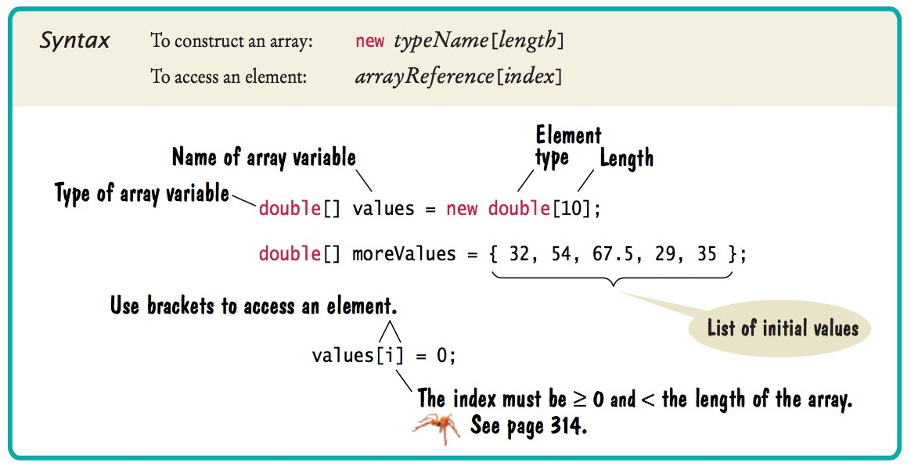
Syntax 7.1 Arrays

Slide 6

Arrays
The elements of arrays are numbered starting at 0.
The following declaration creates an array of 10 elements:
double[] values = new double[10];
An index can be any integer ranging from 0 to 9. The first element is values[0]
The last element is values[9]
An array index must be at least zero and less than the size of the array.
Like a mailbox that is identified by a box number, an array element is identified by an index.

Slide 7
Arrays - Bounds Error
A bounds error occurs if you supply an invalid array index. Causes your program to terminate with a run-time error.
Example:
double[] values = new double[10]; values[10] = value; // Error
values.length yields the length of the values array. There are no parentheses following length.

Slide 8
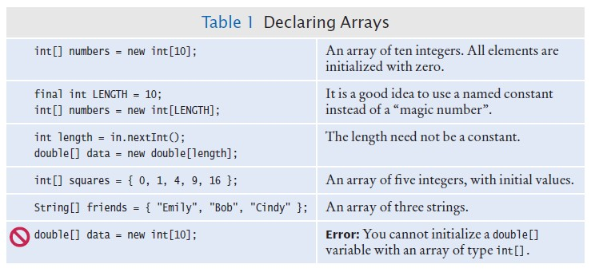
Declaring Arrays

Slide 9
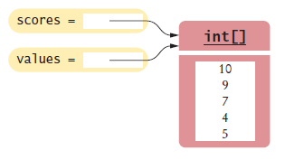
Array References
An array reference specifies the location of an array.
Copying the reference yields a second reference to the same array.
When you copy an array variable into another, both variables refer to the same array
int[] scores = { 10, 9, 7, 4, 5 };
int[] values = scores; // Copying array reference
You can modify the array through either of the variables:
scores[3] = 10; System.out.println(values[3]); // Prints 10
Figure 2 Two Array Variables Referencing the Same Array

Slide 10
Using Arrays with Methods
Arrays can occur as method arguments and return values. An array as a method argument
public void addScores(int[] values)
{
for (int i = 0; i < values.length; i++)
{
totalScore = totalScore + values[i];
}
}
To call this method
int[] scores = { 10, 9, 7, 10 }; fred.addScores(scores);
A method with an array return value
public int[] getScores()

Slide 11
Partially Filled Arrays
Array length = maximum number of elements in array. Usually, array is partially filled
Define an array larger than you will need
final int LENGTH = 100;
double[] values = new double[LENGTH];
Use companion variable to keep track of current size: call it currentSize

Slide 12
Partially Filled Arrays
A loop to fill the array
int currentSize = 0;
Scanner in = new Scanner(System.in); while (in.hasNextDouble())
{
if (currentSize < values.length)
{
values[currentSize] = in.nextDouble(); currentSize++;
}
}
At the end of the loop, currentSize contains the actual number of elements in the array.
Note: Stop accepting inputs when currentSize reaches the array length.

Slide 13
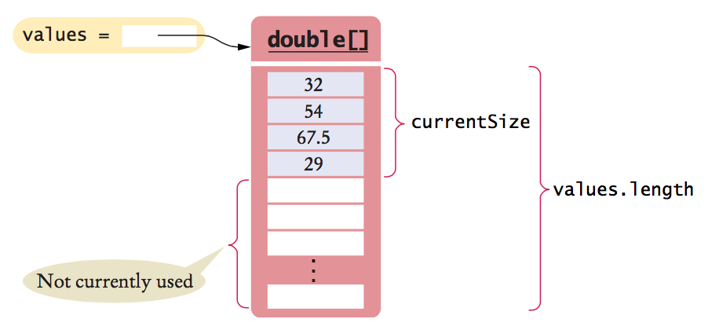
Partially Filled Arrays
Figure 3 A partially-filled array

Slide 14

Partially Filled Arrays
To process the gathered array elements, use the companion variable, not the array length:
for (int i = 0; i < currentSize; i++)
{
System.out.println(values[i]);
}
With a partially filled array, you need to remember how many elements are filled.

Slide 15
Common Array Algorithm: Filling
Fill an array with squares (0, 1, 4, 9, 16, ...):
for (int i = 0; i < values.length; i++)
{
values[i] = i * i;
}

Slide 16
Common Array Algorithm: Sum and Average
To compute the sum of all elements in an array:
double total = 0;
for (double element : values)
{
total = total + element;
}
To obtain the average:
double average = 0;
if (values.length > 0) { average = total / values.length; }

Slide 17

Common Array Algorithm: Maximum or Minimum
Finding the maximum in an array
double largest = values[0];
for (int i = 1; i < values.length; i++)
{
if (values[i] > largest)
{
largest = values[i];
}
}
The loop starts at 1 because we initialize largest with values[0].
Finding the minimum: reverse the comparison.
These algorithms require that the array contain at least one element.

Slide 18

Common Array Algorithm: Element Separators
When you display the elements of an array, you usually want to separate them:
Ann | Bob | Cindy
Note that there is one fewer separator than there are elements
Print the separator before each element except the initial one (with index 0):
for (int i = 0; i < names.size(); i++)
{
if (i > 0)
{
System.out.print(" | ");
}
System.out.print(names.value[i]);
}
To print five elements, you need four separators.

Slide 19
Common Array Algorithm: Linear Search
To find the position of an element:
Visit all elements until you have found a match or you have come to the end of the array
Example: Find the first element that is equal to 100
int searchedValue = 100; int pos = 0;
boolean found = false;
while (pos < values.length && !found)
{
if (values[pos] == searchedValue)
{
found = true;
}
else
{
pos++;
}
}
if (found) { System.out.println("Found at position: " + pos); } else { System.out.println("Not found"); }

Slide 20

Common Array Algorithm: Linear Search
This algorithm is called a linear search.
A linear search inspects elements in sequence until a match is found.
To search for a specific element, visit the elements and stop when you encounter the match.

Slide 21
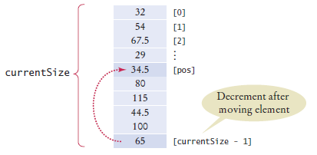
Common Array Algorithm: Removing an Element
Problem: To remove the element with index pos from the array values with number of elements
currentSize.
Unordered
Overwrite the element to be removed with the last element of the array.
Decrement the currentSize variable.
values[pos] = values[currentSize - 1]; currentSize--;
Figure 6 Removing an Element in an Unordered Array

Slide 22
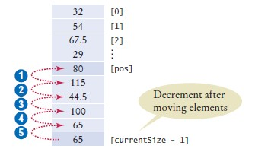
Common Array Algorithm: Removing an Element
Ordered array
Move all elements following the element to be removed to a lower index.
Decrement the variable holding the size of the array.
for (int i = pos + 1; i < currentSize; i++)
{
values[i - 1] = values[i];
}
currentSize--;
Figure 7 Removing an Element in an Ordered Array

Slide 23
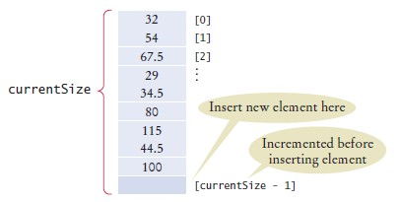
Common Array Algorithm: Inserting an Element
If order does not matter
Insert the new element at the end of the array.
Increment the variable tracking the size of the array.
if (currentSize < values.length)
{
currentSize++
values[currentSize - 1] = newElement;
}
Figure 8 Inserting an Element in an Unordered Array

Slide 24
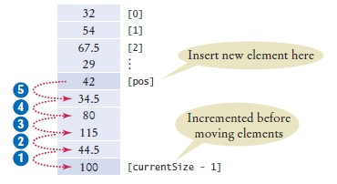
Common Array Algorithm: Inserting an Element
If order matters
Increment the variable tracking the size of the array.
Move all elements after the insertion location to a higher index.
Insert the element .
if (currentSize < values.length)
{
currentSize++;
for (int i = currentSize - 1; i > pos; i--)
{
values[i] = values[i - 1];
}
values[pos] = newElement;
}
Figure 9 Inserting an Element in an Ordered Array

Slide 25

Common Array Algorithm: Swapping Elements
To swap two elements, you need a temporary variable.
We need to save the first value in the temporary variable before replacing it.
double temp = values[i]; values[i] = values[j];
Now we can set values[j] to the saved value.
values[j] = temp;

Slide 26
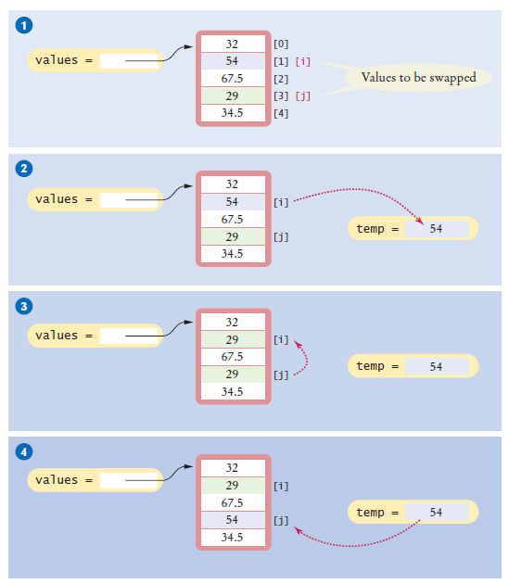
Common Array Algorithm: Swapping Elements
Figure 10 Swapping Array Elements

Slide 27
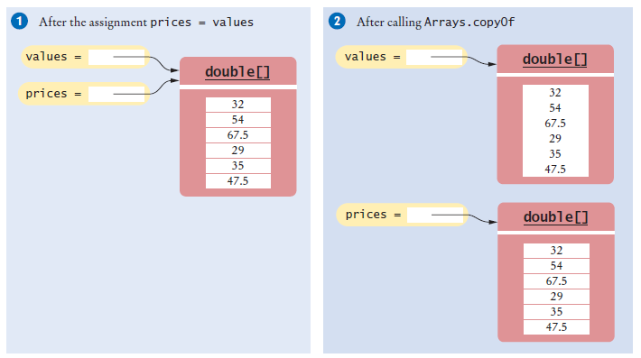
Common Array Algorithm: Copying an Array
Copying an array variable yields a second reference to the same array:
double[] values = new double[6];
. . . // Fill array
double[] prices = values;
To make a true copy of an array, call the Arrays.copyOf method:
double[] prices = Arrays.copyOf(values, values.length);
Figure 11 Copying an Array Reference versus Copying an Array
To use the Arrays class, you need to add the following statement to the top of your program
import java.util.Arrays;

Slide 28
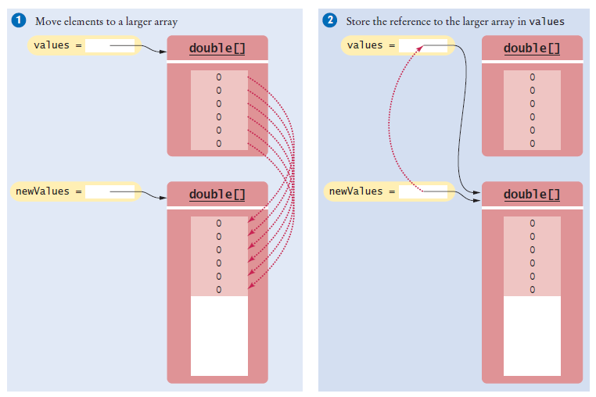
Common Array Algorithm: Growing an Array
To grow an array that has run out of space, use the Arrays.copyOf method: To double the length of an array
double[] newValues = Arrays.copyOf(values, 2 * values.length); values = newValues;
Figure 12 Growing an Array

